Slide 1
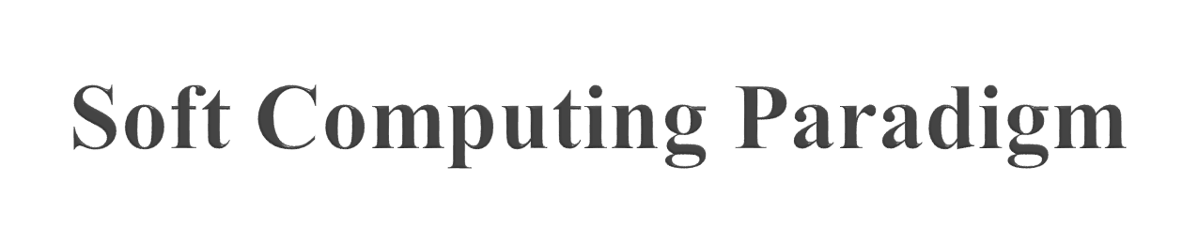
Lecture Module 23

Slide 2

The idea behind soft computing is to model cognitive behavior of human mind.
Soft computing is foundation of conceptual intelligence in machines.
Unlike hard computing , Soft computing is tolerant of imprecision, uncertainty, partial truth, and approximation.

Slide 3
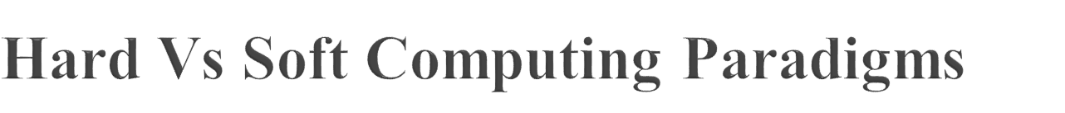
Hard computing
  Based on the concept of precise modelling and analysing to yield accurate results.
  Works well for simple problems, but is bound by the NP-Complete set.
Soft computing
  Aims to surmount NP-complete problems.
  Uses inexact methods to give useful but inexact answers to intractable problems.
  Represents a significant paradigm shift in the aims of computing - a shift which reflects the human mind.
  Tolerant to imprecision, uncertainty, partial truth, and approximation.
  Well suited for real world problems where ideal models are not available.

Slide 4
Components of soft computing include:
  Fuzzy Logic (FL)
  Evolutionary Computation (EC) - based on the origin of the species
    Genetic Algorithm
    Swarm Intelligence
    Ant Colony Optimizations
  Neural Network (NN)
  Machine Learning (ML)

Slide 5
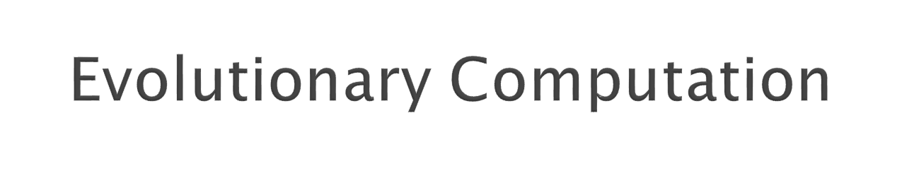
Genetic and Swarm Computing

Slide 6
General term for several computational techniques inspired by biological evolution
EC mostly involve meta-heuristic optimization algorithms such as:
  Evolutionary algorithms
    comprising genetic algorithms, evolutionary programming, etc)
  Swarm intelligence
    comprising ant colony optimization and particle swarm optimization)

Slide 7
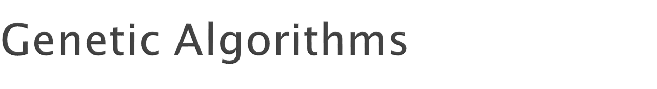
Genetic algorithms are inspired by Darwin's theory of natural evolution.
In the natural world, organisms that are poorly suited for an environment die off, while those well-suited, prosper.
Genetic algorithms search the space of individuals for good candidates.
The chance of an individual's being selected is proportional to the amount by which its fitness is greater or less than its competitors' fitness.

Slide 8
Algorithm begins with a set of initial solutions (represented by set of chromosomes) called population.
A chromosome is a string of elements called genes.
Solutions from one population are taken and are used to form a new population by generating offsprings.
New population is formed using old population and offspring based on their fitness value.
Promising candidates are kept and allowed to reproduce
This is motivated by a hope, that the new population will be better than the old one.
Genetic algorithms are broadly applicable and have the advantage that they require little knowledge encoded in the system.

Slide 9
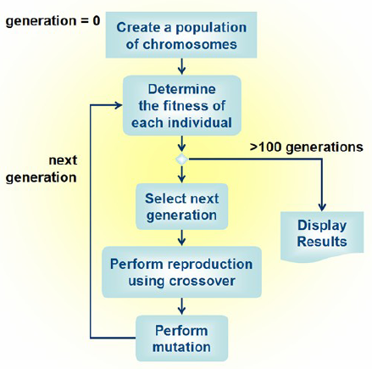

Slide 10
[Start] Generate random population of n chromosomes (suitable solutions for the problem).
[Fitness] Evaluate the fitness f(x) of each chromosome x in the population.
Repeat until terminating condition is satisfied
  [Selection] Select two parent chromosomes from a population according to their fitness (the better fitness, the bigger chance to be selected).
  [Crossover] Crossover the parents to form new offsprings (children). If no crossover was performed, offspring is the exact copy of parents.
  [Mutation] Mutate new offspring at selected position(s) in chromosome).
  [Accepting] Generate new population by placing new offsprings.
Return the best solution in current population

Slide 11
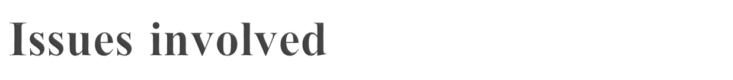
    How to create chromosomes and what type of encoding to choose?
    How to perform Crossover and Mutation, the two basic operators of GA?
    How to select parents for crossover?

Slide 12
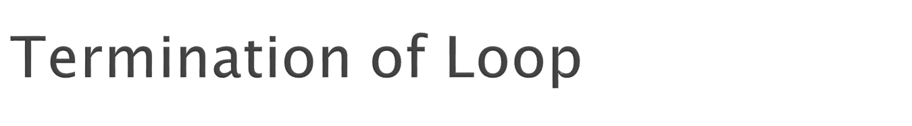
  Reaching some (known/hoped for) fitness.
  Reaching some maximum allowed number of generations.
  Reaching some minimum level of diversity.
  Reaching some specified number of generations without fitness improvement.

Slide 13

Applicable when little knowledge is encoded in the system.
Effective way of finding a reasonable solution to a complex problem quickly.
NP-complete problems can be solved in efficient way.
Parallelism and easy implementation is an advantage.
However, they give very poor performance on some problems as might be expected from knowledge-poor approaches.

Slide 14
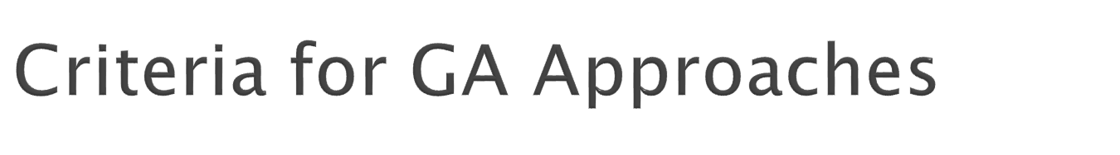
Completeness: Any solution should have its encoding
Non redundancy: Codes and solutions should correspond one to one
Soundness: Any code (produced by genetic operators) should have its corresponding solution
Characteristic perseverance: Offspring should inherit useful characteristics from parents.

Slide 15

Represents the requirements that the population should adapt to
  quality function or objective function
The fitness is calculated by first decoding the chromosome and then the evaluating the objective function.
Fitness function is and indicator of how close the chromosome is to the optimal solution
Typically we talk about fitness being maximised
  Some problems may be best posed as minimisation problems, but conversion is trivial

Slide 16
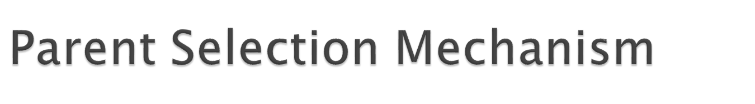
Depending on their finesses -Assigns variable probabilities of individuals acting as parents
Usually probabilistic
  high quality solutions more likely to become parents than low quality
  but not guaranteed
  even the worst in current population usually has non-zero probability of becoming a parent
This stochastic nature can aid escape from local optima

Slide 17

Most EAs use fixed population size so need a way of going from (parents + offspring) to next generation
Often deterministic
  Fitness based : e.g., rank parents + offspring and take best
  Age based: make as many offspring as parents and delete all parents
Sometimes do combination of above two

Slide 18
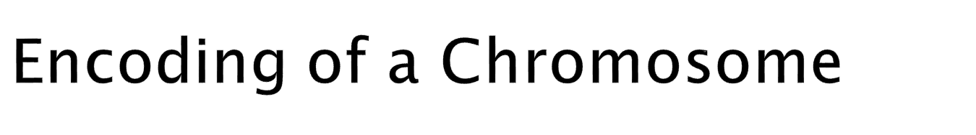
A chromosome should contain information about solution that it represents.
The commonly used way of encoding is a binary string.
Chromosome 1: 1101100100110110 Chromosome 2: 1101111000011110
Each bit in the string represents some characteristics of the solution.
There are many other ways of encoding. The encoding depends mainly on the problem.

Slide 19
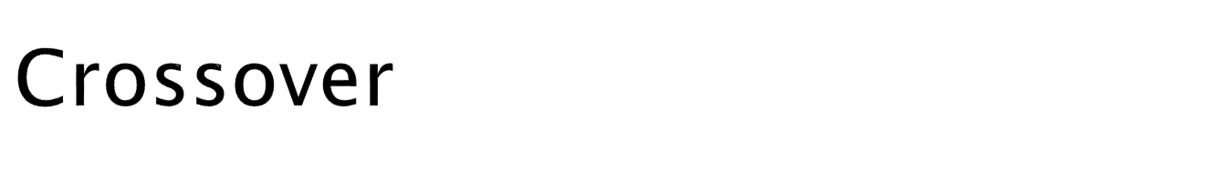
Crossover operates on selected genes from parent chromosomes and creates new offspring.
The simplest way is to choose some crossover point randomly
  copy everything before this point from the first parent and then copy everything after the crossover point from the other parent.

Slide 20
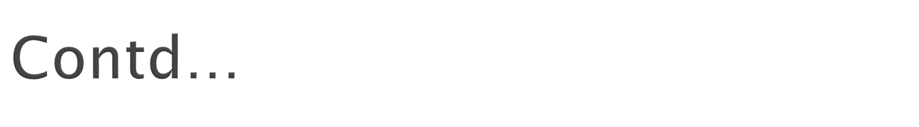
Example: ( | is the crossover point):
Chromosome 1 11011 | 00100110110 Chromosome 2 11011 | 11000011110 Offspring 1 11011 | 11000011110
Offspring 2 11011 | 00100110110
There are other ways to make crossover, for example we can choose more crossover points.
Crossover can be quite complicated and depends mainly on the encoding of chromosomes.
Specific crossover made for a specific problem can improve performance of the genetic algorithm.

Slide 21
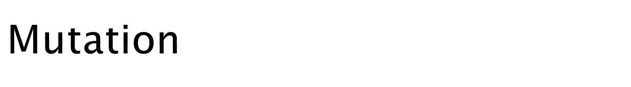
Mutation operation randomly changes the offspring resulted from crossover.
Mutation is intended to prevent falling of all solutions in the population into a local optimum of the problem.
In case of binary encoding we can switch a few randomly chosen bits from 1 to 0 or from 0 to 1.
Mutation can be then illustrated as follows:
Original offspring 1 1101111000011110
Original offspring 2 1101100100110110
Mutated offspring 1 1100111000011110
Mutated offspring 2 1101101100110100
The technique of mutation (as well as crossover) depends mainly on the encoding of chromosomes.

Slide 22
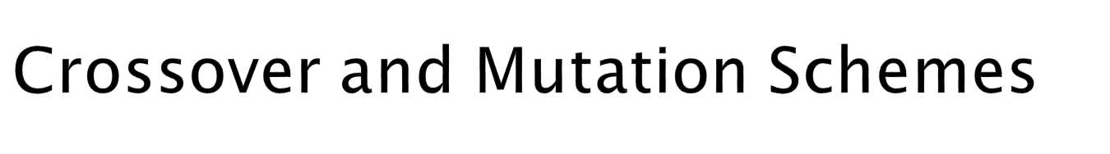
As already mentioned, crossover and mutation are two basic operations of GA.
Performance of GA depends on the encoding and also on the problem.
There are several encoding schemes to perform crossover and mutation.

Slide 23
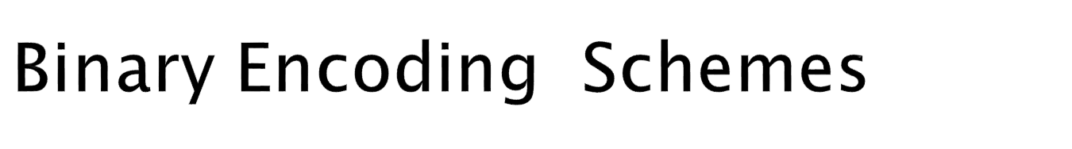
Binary Encoding
1. Crossover
Single point crossover:
  one crossover point is selected,
  binary string from the beginning of the chromosome to the crossover point is copied from the first parent,
  the rest is copied from the other parent
  11001011+11011111 = 11001111

Slide 24
  Two point crossover:
    two crossover points are selected,
    binary string from the beginning of the chromosome to the first crossover point is copied from the first parent,
    the part from the first to the second crossover point is copied from the other parent and
    the rest is copied from the first parent again
  11001001 + 11011111 = 11011101

Slide 25
  Arithmetic crossover: Arithmetic operation is performed to make a new offspring
  11001011 + 11011111 = 11001001 (AND)
  Uniform crossover: bits are randomly copied from the first and second parent
  11101010 + 11010101 = 11010011
2. Mutation
  Bit inversion: selected bits are inverted
  11010011 => 11110010

Slide 26
1. Crossover : Single point crossover -
  one crossover point is selected,
  the genes are copied from the first parent till the crossover point, then
  the other parent is scanned and if the gene is not yet copied in the offspring, it is added
  Note: there are more ways to produce the rest after crossover point
  (1 2 3 4 5 6 7 8 9) + (4 5 3 6 8 9 7 2 1) =
  (1 2 3 4 5 6 8 9 7)
2. Mutation: Order changing -
  two numbers are selected and exchanged
  (1 2 3 4 5 6 8 9 7) => (1 8 3 4 5 6 2 9 7)

Slide 27
Value Encoding
1. Crossover
  All crossovers methods from binary encoding can be used
2. Mutation
  Adding (for real value encoding) - a small number is added to (or subtracted from) selected values
  (1.29 5.68 2.86 4.11 5.55) => (1.29 5.68 2.73 4.22 5.55)
Tree Encoding
1. Crossover
  Tree crossover - one crossover point is selected in both parents, and the parts below crossover points are exchanged to produce new offspring
2. Mutation
  Changing operator, number - selected nodes are changed

Slide 28
Applicable when little knowledge is encoded in the system.
Effective way of finding a reasonable solution to a complex problem quickly.
NP-complete problems can be solved in efficient way.
Parallelism and easy implementation is an advantage.
However, they give very poor performance on some problems as might be expected from knowledge-poor approaches.

Slide 29
There are NP-complete problems that can not be solved algorithmically in efficient way.
NP stands for nondeterministic polynomial and it means that it is possible to guess the solution and then check it in polynomial time.
If we have some mechanism to guess a solution, then we would be able to find a solution in some reasonable or polynomial time .
The characteristic for NP-problems is that algorithm is usually O(2^{n}) and it is not usable when n is large.
For such problems, GA works well.
But the disadvantage of GAs is in their computational time.

Slide 30
They can be slower than some other methods.
Some of the problems are listed below
  Choosing encoding and fitness function can be difficult.
  GAs may have a tendency to converge towards local optima or even arbitrary points rather than the global optimum in many problems..
GAs cannot effectively solve problems in which the only fitness measure is right/wrong, as there is no way to converge on the solution.
In these cases, a random search may find a solution as quickly as a GA.

Slide 31
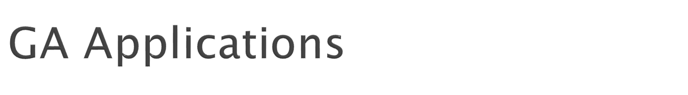
Control
Design
Scheduling
Robotics
Machine Learning
Signal Processing
Game Playing
Combinatorial Optimization

Slide 32
TSP and sequence scheduling
Finding shape of protein molecules
Strategy planning
Nonlinear dynamical systems - predicting, data analysis
Designing neural networks, both architecture and weights
Evolving LISP programs (genetic programming)

Slide 33
Genetic programming starts with randomly created computer programs and evolves programs progressively over a series of generations similar to genetic algorithm.
Furthermore, genetic programming is useful in finding solutions where the variables are constantly changing.
A population of random trees representing programs is constructed.

Slide 34
The genetic operators (crossover, reproduction, etc.) are performed on these trees.
In order to create these individuals, two distinct sets are defined:
  the terminal set T, and
  the function set F.
The terminal set includes variables, as well as constants.
All the functions and terminals must be compatible (i.e. can pass information between each other).
Random tree is generated until all the branches end in terminals.
To generate a population of programs, just generate as many trees as needed.

Slide 35
Initially generate a population of random compositions of the functions and terminals of the problem (computer programs).
Execute each program in the population and assign it a fitness value according to how well it solves the problem.
Create a new population of computer programs.
Copy the best existing programs.
Create new computer programs by mutation.
Create new computer programs by crossover.
The best computer program that appeared in any generation is designated as the result of genetic programming.

Slide 36
In tree encoding every chromosome is a tree of some objects, such as functions or commands in programming language.
LISP programming language is often used for this, as programs in LISP are represented in this form of list and can be easily parsed as a tree.
The crossover and mutation operations can be done easily.

Slide 37
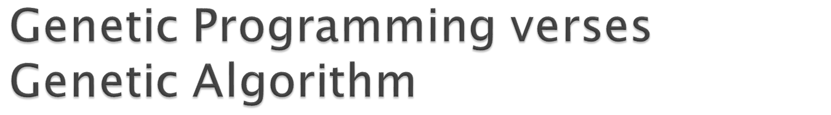
Advantages of genetic programming over genetic algorithm is that
  identical parents can yield different offsprings,
  while in genetic algorithms identical parents would yield identical offspring.

Slide 38
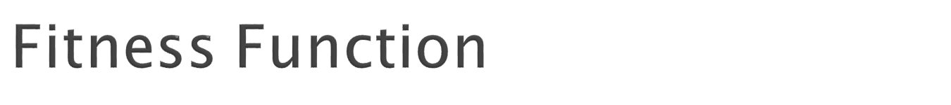
The most difficult and important concept of GP is the fitness function.
The fitness function determines how well a program is able to solve the problem.
It varies greatly from one type of program to the next.
For example, if one were to create a genetic program to set the time of a clock, the fitness function would simply be the amount of time that the clock is wrong.

Slide 39
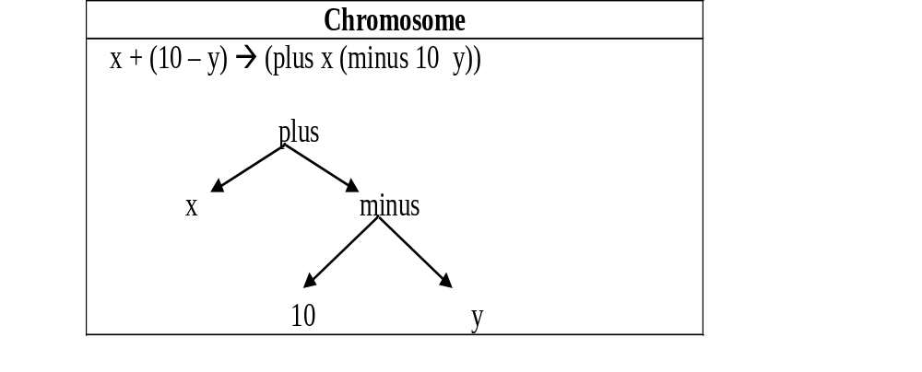

Slide 40
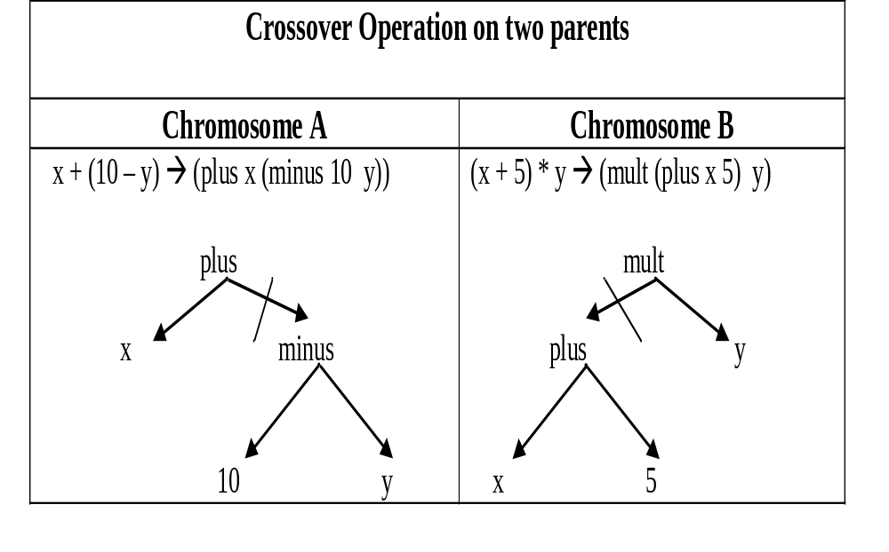

Slide 41
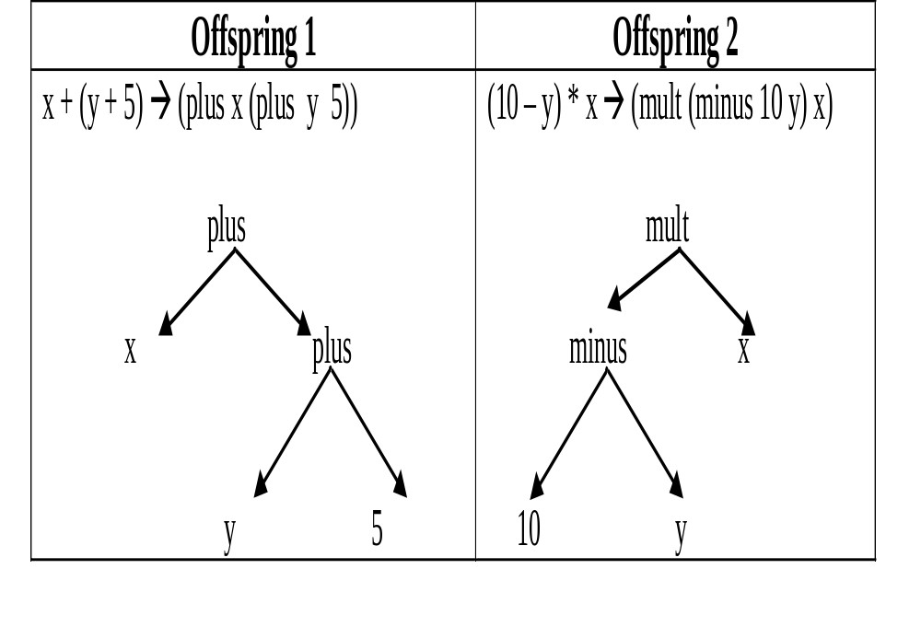

Slide 42
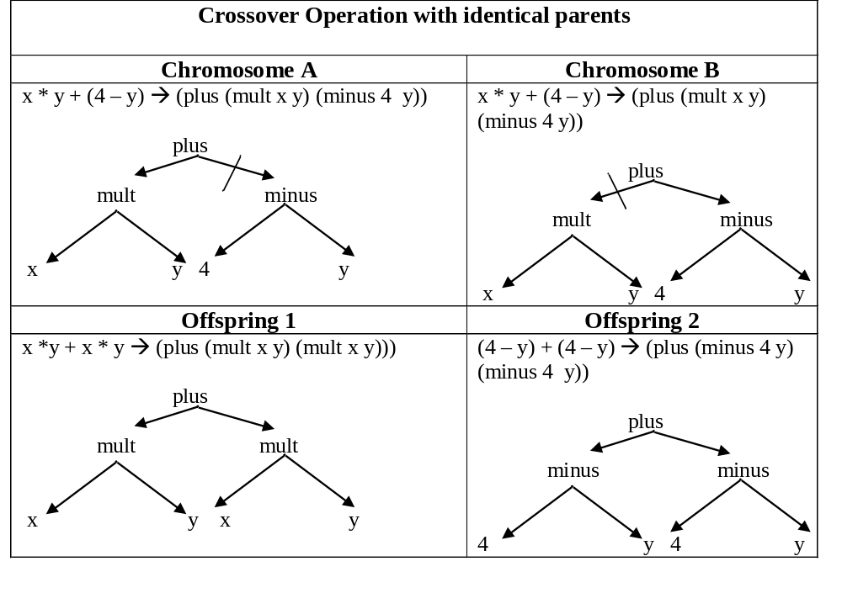

Slide 43
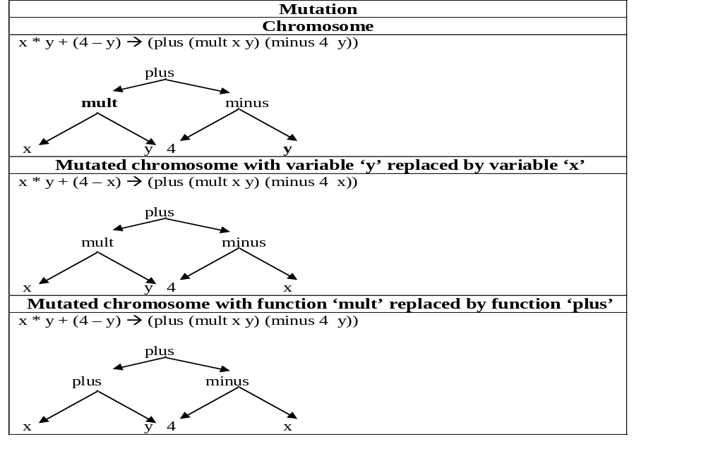

Slide 44
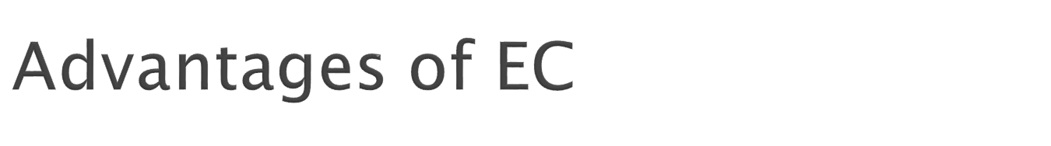
Conceptual Simplicity
Broad Applicability
Hybridization with Other Methods
Parallelism
Robust to Dynamic Changes
Solves Problems that have no Solutions

